Slide 1

CHAPTER 8
RELATIONS
Copyright © Cengage Learning. All rights reserved.

Slide 2
SECTION 8.1
Relations on Sets
Copyright © Cengage Learning. All rights reserved.

Slide 3
Relations on Sets
A more formal way to refer to the kind of relation defined on sets is to call it a binary relation because it is a subset of a Cartesian product of two sets.
At the end of this section we define an n-ary relation to be a subset of a Cartesian product of n sets, where n is any integer greater than or equal to two.
Such a relation is the fundamental structure used in relational databases. However, because we focus on binary relations in this text, when we use the term relation by itself, we will mean binary relation.

Slide 4
Example 2 – The Congruence Modulo 2 Relation
Define a relation E from Z to Z as follows: For all (m, n) ∈ Z × Z,
Is 4 E 0? Is 2 E 6? Is 3 E (–3)? Is 5 E 2?
List five integers that are related by E to 1.
Prove that if n is any odd integer, then n E 1.
Solution:
Yes, 4 E 0 because 4 – 0 = 4 and 4 is even.
Yes, 2 E 6 because 2 – 6 = –4 and –4 is even.

Slide 5

Example 2 – Solution
cont’d
Yes, 3 E (–3) because 3 – (–3) = 6 and 6 is even.
No, 5 2 because 5 – 2 = 3 and 3 is not even.
b. There are many such lists. One is
1 because 1 – 1 = 0 is even,
3 because 3 – 1 = 2 is even,
5 because 5 – 1 = 4 is even,
–1 because –1 – 1 = –2 is even,
–3 because –3 – 1 = –4 is even.

Slide 6
Example 1 – Solution
cont’d
c. Proof:
Suppose n is any odd integer.
Then n = 2k + 1 for some integer k. Now by definition of
E, n E 1 if, and only if, n – 1 is even.
But by substitution,
n – 1 = (2k + 1) – 1 = 2k,
and since k is an integer, 2k is even. Hence n E 1 [as was to be shown].

Slide 7
Example 1 – Solution
cont’d
It can be shown that integers m and n are related by E if, and only if, m mod 2 = n mod 2 (that is, both are even or both are odd).
When this occurs m and n are said to be congruent modulo 2.

Slide 8
The Inverse of a Relation

Slide 9
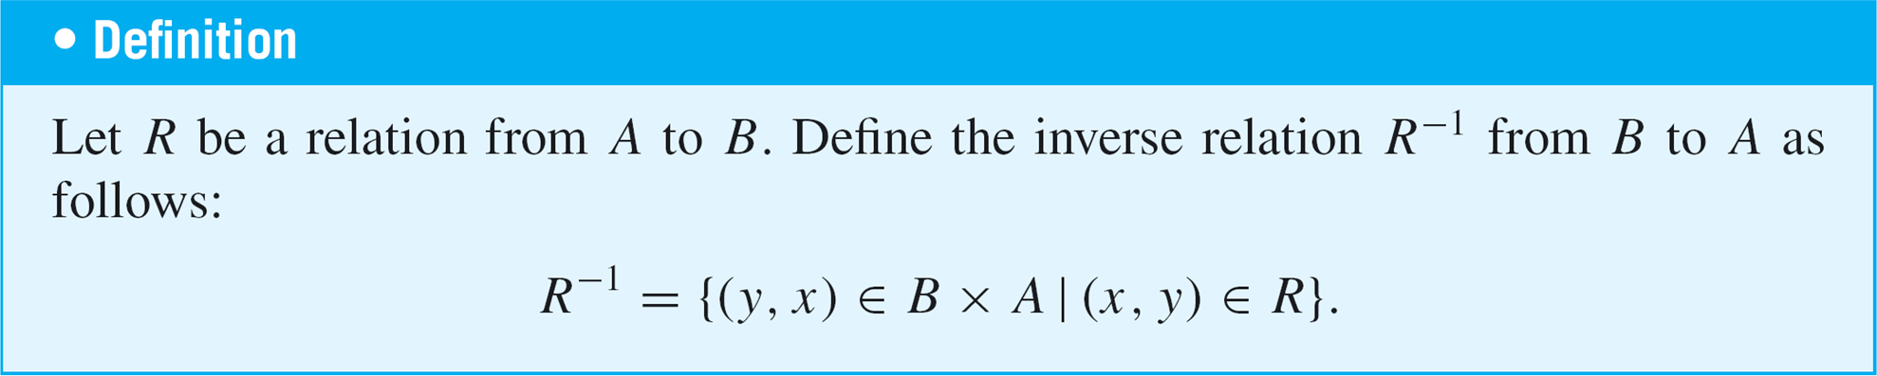

The Inverse of a Relation
If R is a relation from A to B, then a relation R^{–1} from B to A can be defined by interchanging the elements of all the ordered pairs of R.
This definition can be written operationally as follows:

Slide 10
Example 4 – The Inverse of a Finite Relation
Let A = {2, 3, 4} and B = {2, 6, 8} and let R be the “divides” relation from A to B: For all (x, y) ∈ A × B,
State explicitly which ordered pairs are in R and R^{–1}, and draw arrow diagrams for R and R^{–1}.
Describe R^{–1} in words.
Solution:
R = {(2, 2), (2, 6), (2, 8), (3, 6), (4, 8)}
R^{–1} = {(2, 2), (6, 2), (8, 2), (6, 3), (8, 4)}

Slide 11
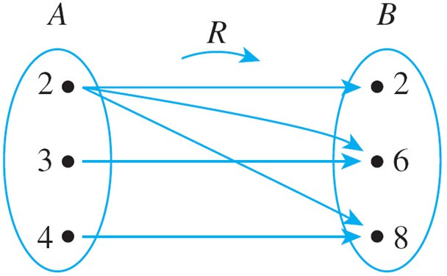
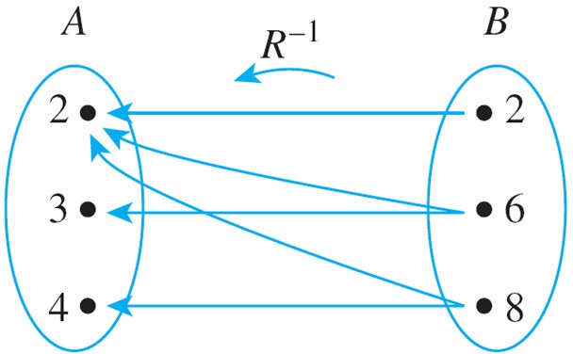
Example 4 – Solution
cont’d
To draw the arrow diagram for R^{–1}, you can copy the arrow diagram for R but reverse the directions of the arrows.

Slide 12
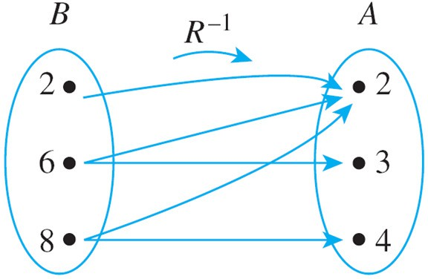
Example 4 – Solution
cont’d
Or you can redraw the diagram so that B is on the left.
b. R^{–1} can be described in words as follows: For all (y, x) ∈ B × A,
y R^{–1} x ⇔ y is a multiple of x.

Slide 13
Directed Graph of a Relation

Slide 14
Directed Graph of a Relation
When a relation R is defined on a set A, the arrow diagram of the relation can be modified so that it becomes a directed graph.
Instead of representing A as two separate sets of points, represent A only once, and draw an arrow from each point of A to each related point.

Slide 15
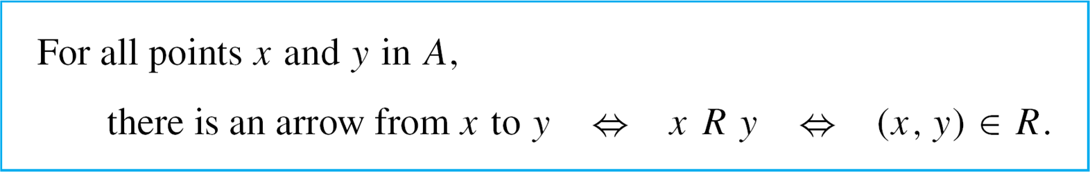
Directed Graph of a Relation
As with an ordinary arrow diagram,
If a point is related to itself, a loop is drawn that extends out from the point and goes back to it.

Slide 16
Example 6 – Directed Graph of a Relation
Let A = {3, 4, 5, 6, 7, 8} and define a relation R on A as follows: For all x, y ∈ A,
x R y ⇔ 2 | (x – y).
Draw the directed graph of R.
Solution:
Note that 3 R 3 because 3 – 3 = 0 and 2 | 0 since 0 = 2 🞄 0. Thus there is a loop from 3 to itself.
Similarly, there is a loop from 4 to itself, from 5 to itself, and so forth, since the difference of each integer with itself is 0, and 2 | 0.

Slide 17
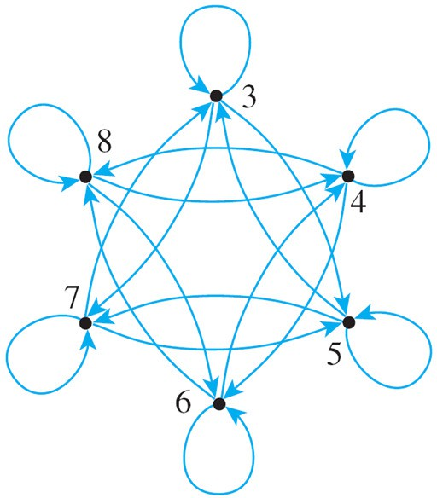
Example 6 – Solution
cont’d
Note also that 3 R 5 because 3 – 5 = –2 = 2 . (–1). And
5 R 3 because 5 – 3 = 2 = 2 .1.
Hence there is an arrow from 3 to 5 and also an arrow from 5 to 3.
The other arrows in the directed graph, as shown below, are obtained by similar reasoning.

Slide 18
N-ary Relations and Relational Databases

Slide 19
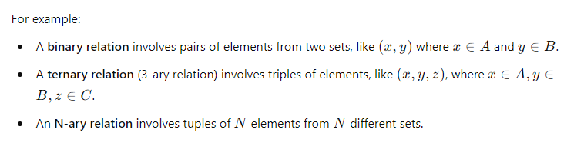
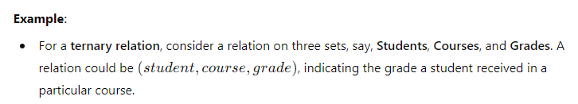
N-ary Relations and Relational Databases

Slide 20
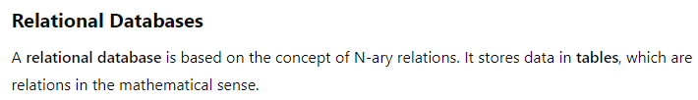
N-ary Relations and Relational Databases

Slide 21
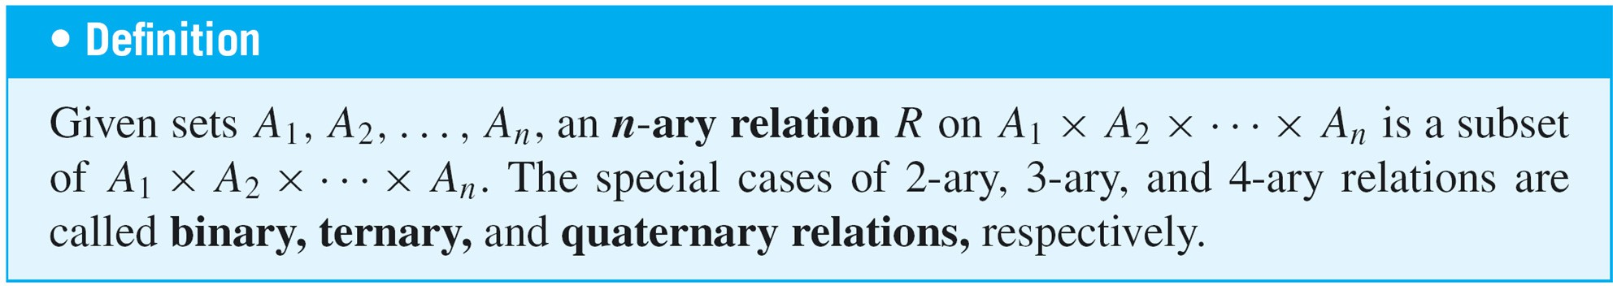
N-ary Relations and Relational Databases
N-ary relations form the mathematical foundation for relational database theory.
A binary relation is a subset of a Cartesian product of two sets, similarly, an n-ary relation is a subset of a Cartesian product of n sets.

Slide 22
Example 7 – A Simple Database
The following is a radically simplified version of a database that might be used in a hospital.
Let A₁ be a set of positive integers, A₂ a set of alphabetic character strings, A₃ a set of numeric character strings, and A₄ a set of alphabetic character strings.
Define a quaternary relation R on A₁ × A₂ × A₃ × A₄ as follows:
(a₁, a₂, a₃, a₄) ∈ R ⇔
a patient with patient ID number a₁, named a₂, was admitted on date a₃, with primary diagnosis a₄.

Slide 23
Example 7 – A Simple Database
cont’d
At a particular hospital, this relation might contain the following 4-tuples:
(011985, John Schmidt, 020710, asthma)
(574329, Tak Kurosawa, 0114910, pneumonia)
(466581, Mary Lazars, 0103910, appendicitis)
(008352, Joan Kaplan, 112409, gastritis)
(011985, John Schmidt, 021710, pneumonia)
(244388, Sarah Wu, 010310, broken leg)
(778400, Jamal Baskers, 122709, appendicitis)

Slide 24
Example 7 – A Simple Database
cont’d
In discussions of relational databases, the tuples are normally thought of as being written in tables.
Each row of the table corresponds to one tuple, and the header for each column gives the descriptive attribute for the elements in the column.
Operations within a database allow the data to be manipulated in many different ways.

Slide 25
Example 7 – A Simple Database
cont’d
For example, in the database language SQL, if the above database is denoted S, the result of the query
SELECT Patient_ID#, Name FROM S WHERE Admission_Date = 010310
would be a list of the ID numbers and names of all patients admitted on 01-03-10:
466581 Mary Lazars,
244388 Sarah Wu.

Slide 26
Example 7 – A Simple Database
cont’d
This is obtained by taking the intersection of the set A₁ × A₂ × {010310} × A₄ with the database and then projecting onto the first two coordinates.
Similarly, SELECT can be used to obtain a list of all admission dates of a given patient.
For John Schmidt this list is
02-07-10 and
02-17-10

Slide 27
Example 7 – A Simple Database
cont’d
Individual entries in a database can be added, deleted, or updated, and most databases can sort data entries in various ways.
In addition, entire databases can be merged, and the entries common to two databases can be moved to a new database.

